Slide 1
Mansion exterior
Garrett Jacobs Mansion 1872-2015

Slide 2
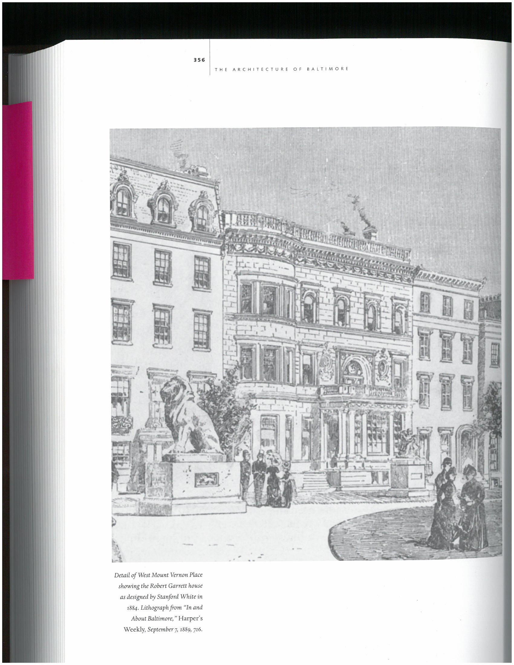

Slide 3
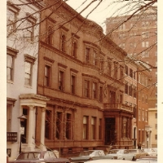
Mansion in 1970s

Slide 4
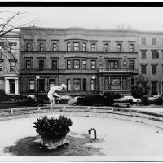
Garrett Jacobs 1970s

Slide 5
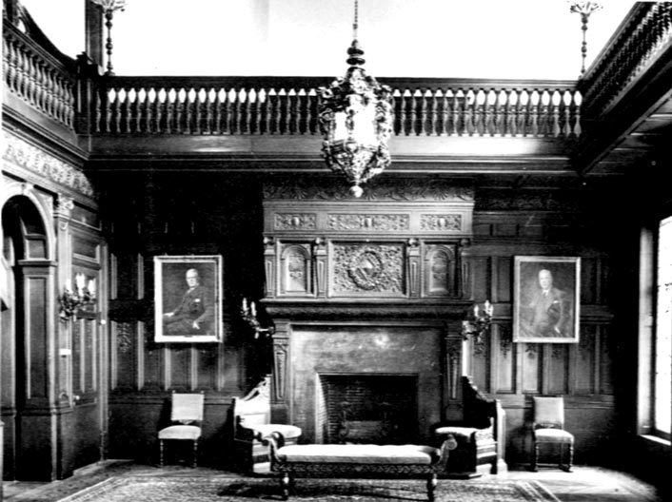
Foyer

Slide 6
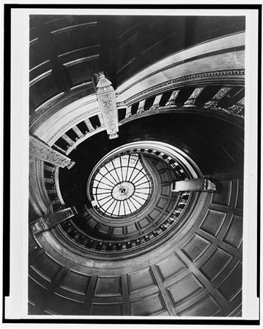
Foyer spiral stairwell with Tiffany dome

Slide 7
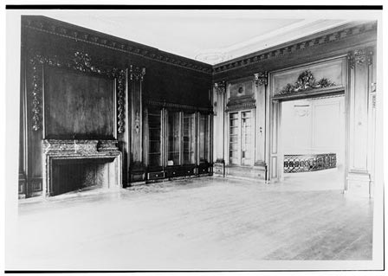
Library unfurnished

Slide 8
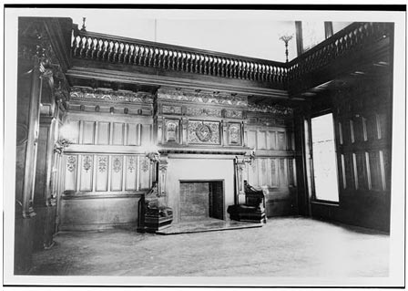
Foyer Unfurnished

Slide 9
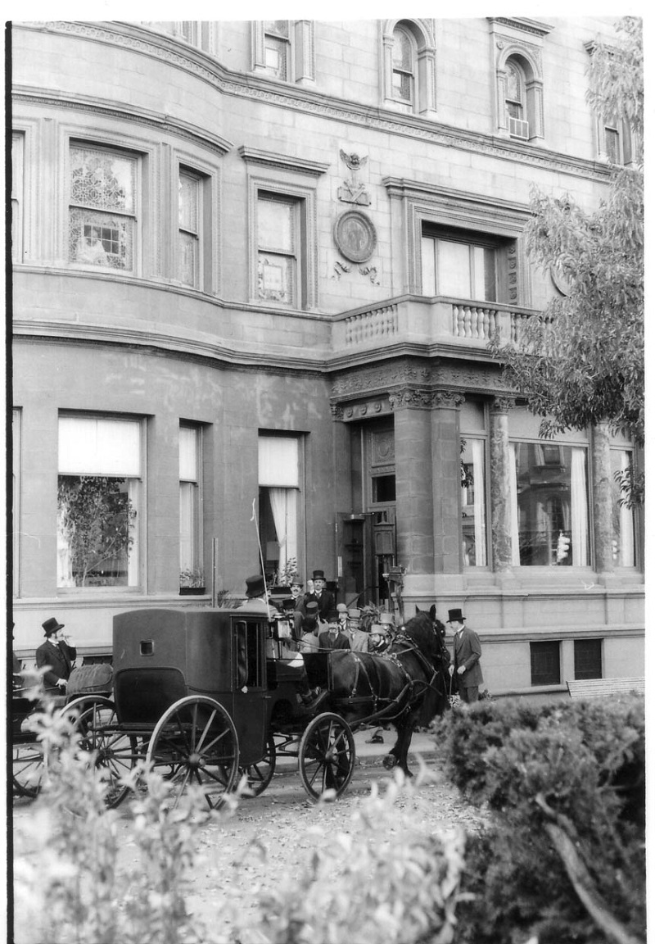
Mansion and carriage

Slide 10
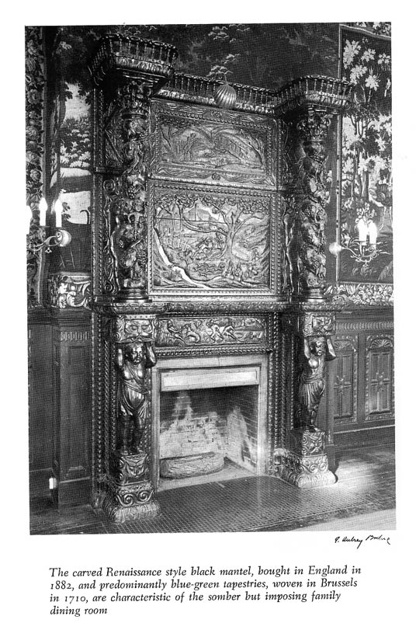
Heritage Room fireplace & mantle

Slide 11
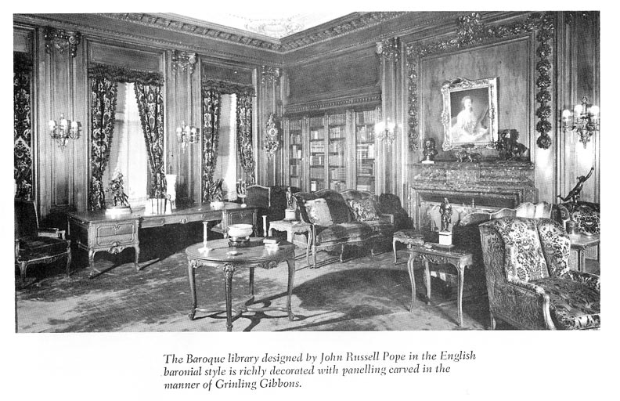
Library c. 1908

Slide 12
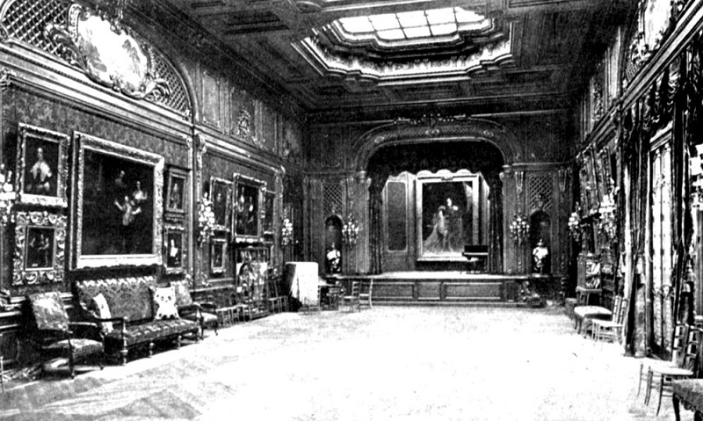
Ballroom c. 1908

Slide 13
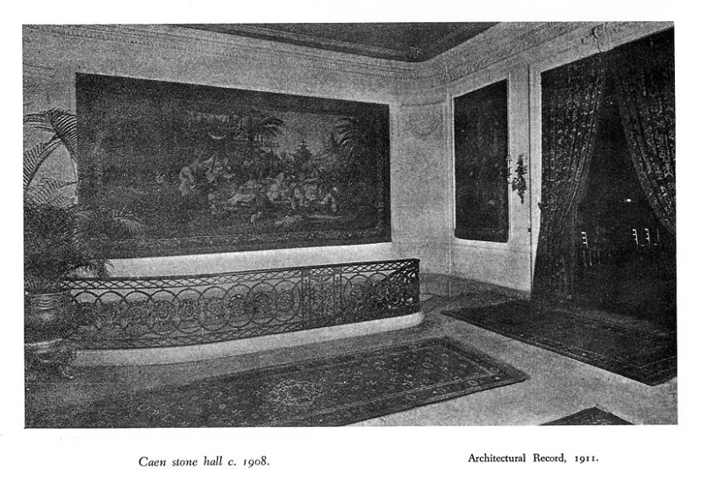
Caen Stone Hall c. 1908

Slide 14
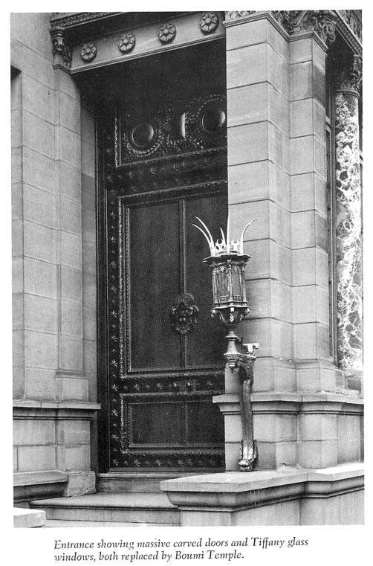
Entry doors

Slide 15
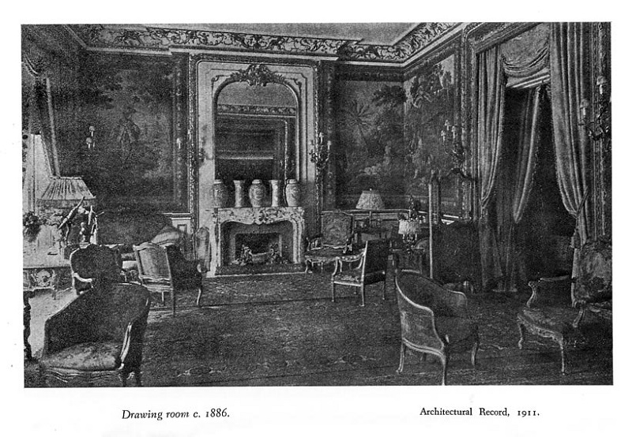
Drawing Room c. 1886

Slide 16
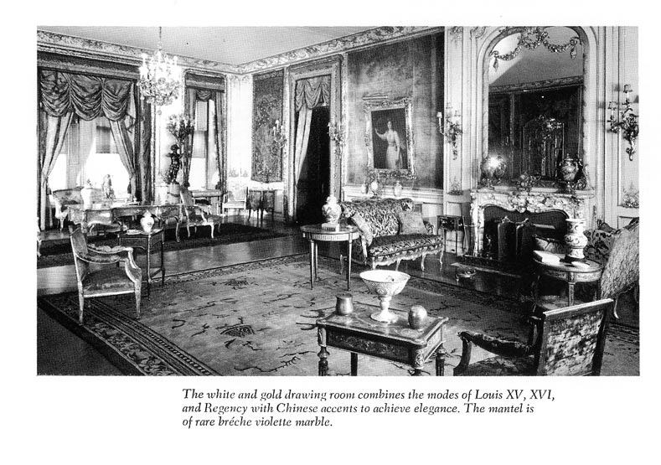
Drawing Room c. 1908

Slide 17
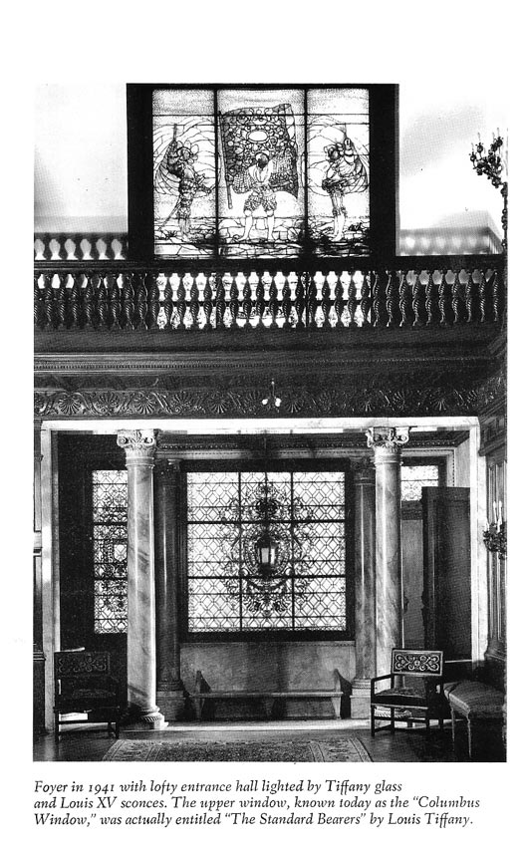
Foyer, Standard Bearers

Slide 18
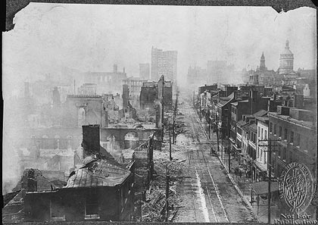
Aftermath of 1904 Fire

Slide 19
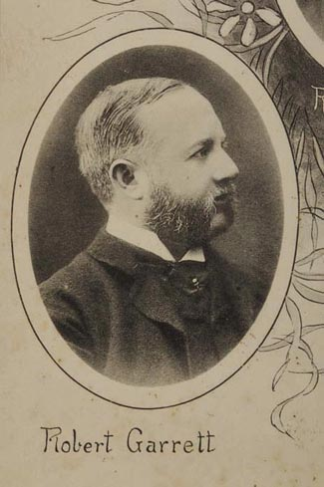
Early Robert Garrett Image

Slide 20
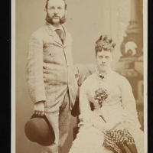
Early Robert and Mary Garrett

Slide 21
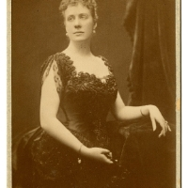
Mary Elizabeth Jacobs

Slide 22
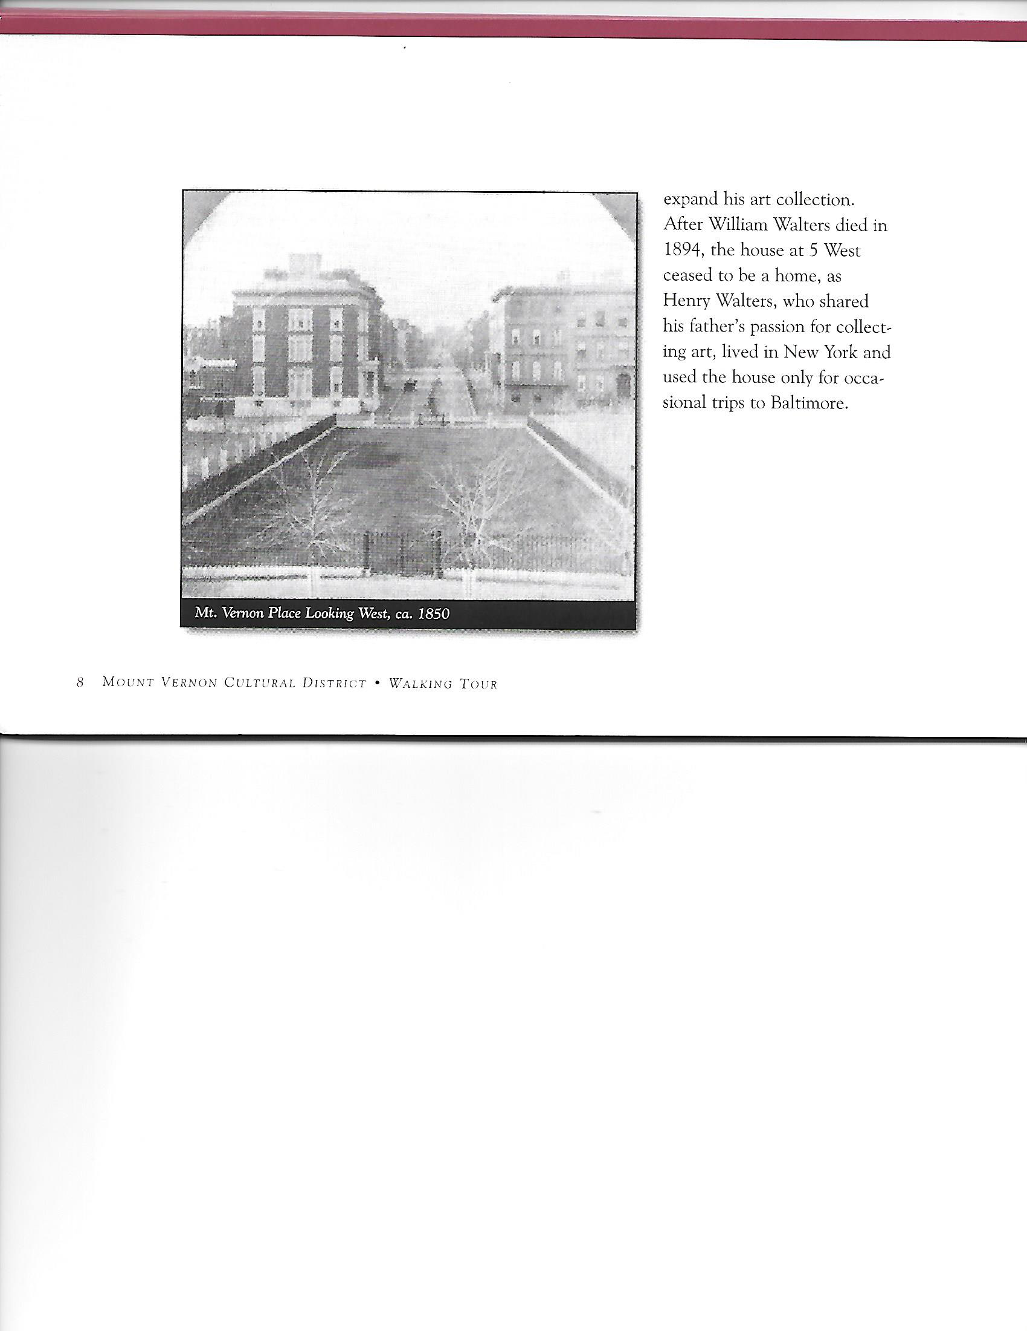
John Work Garrett Home Mt Vernon Place

Slide 23
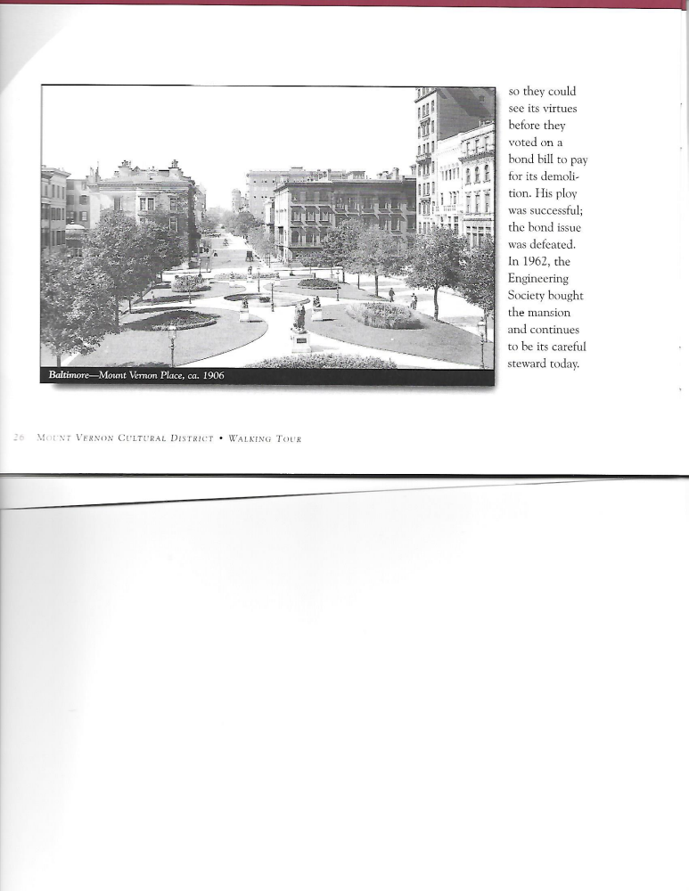
Mt. Vernon Place c 1906

Slide 24
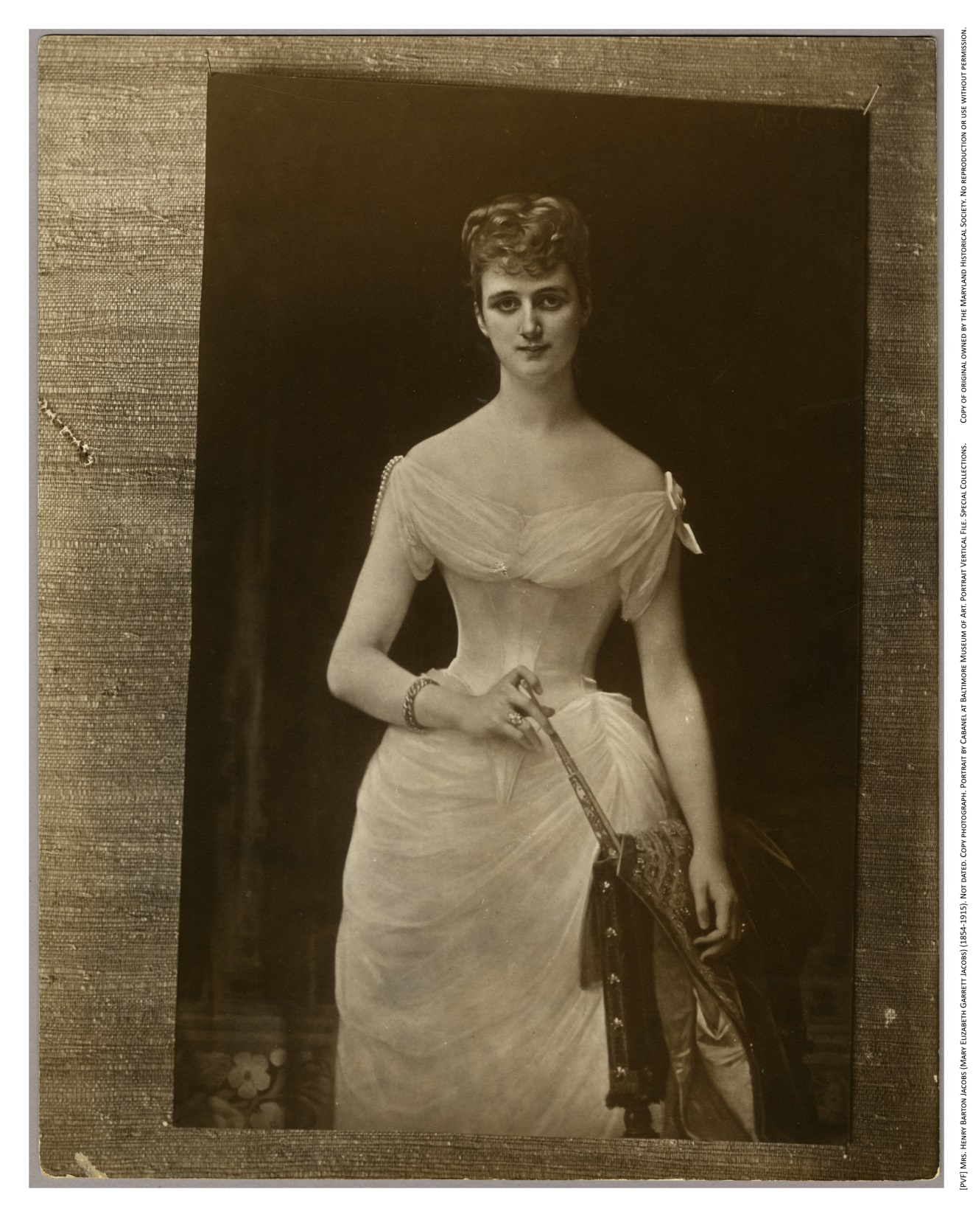

Slide 25
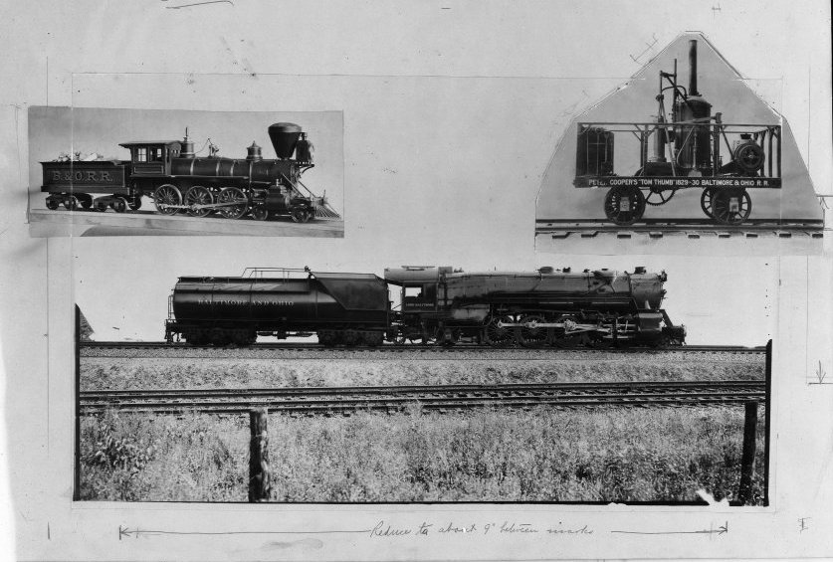

Slide 26
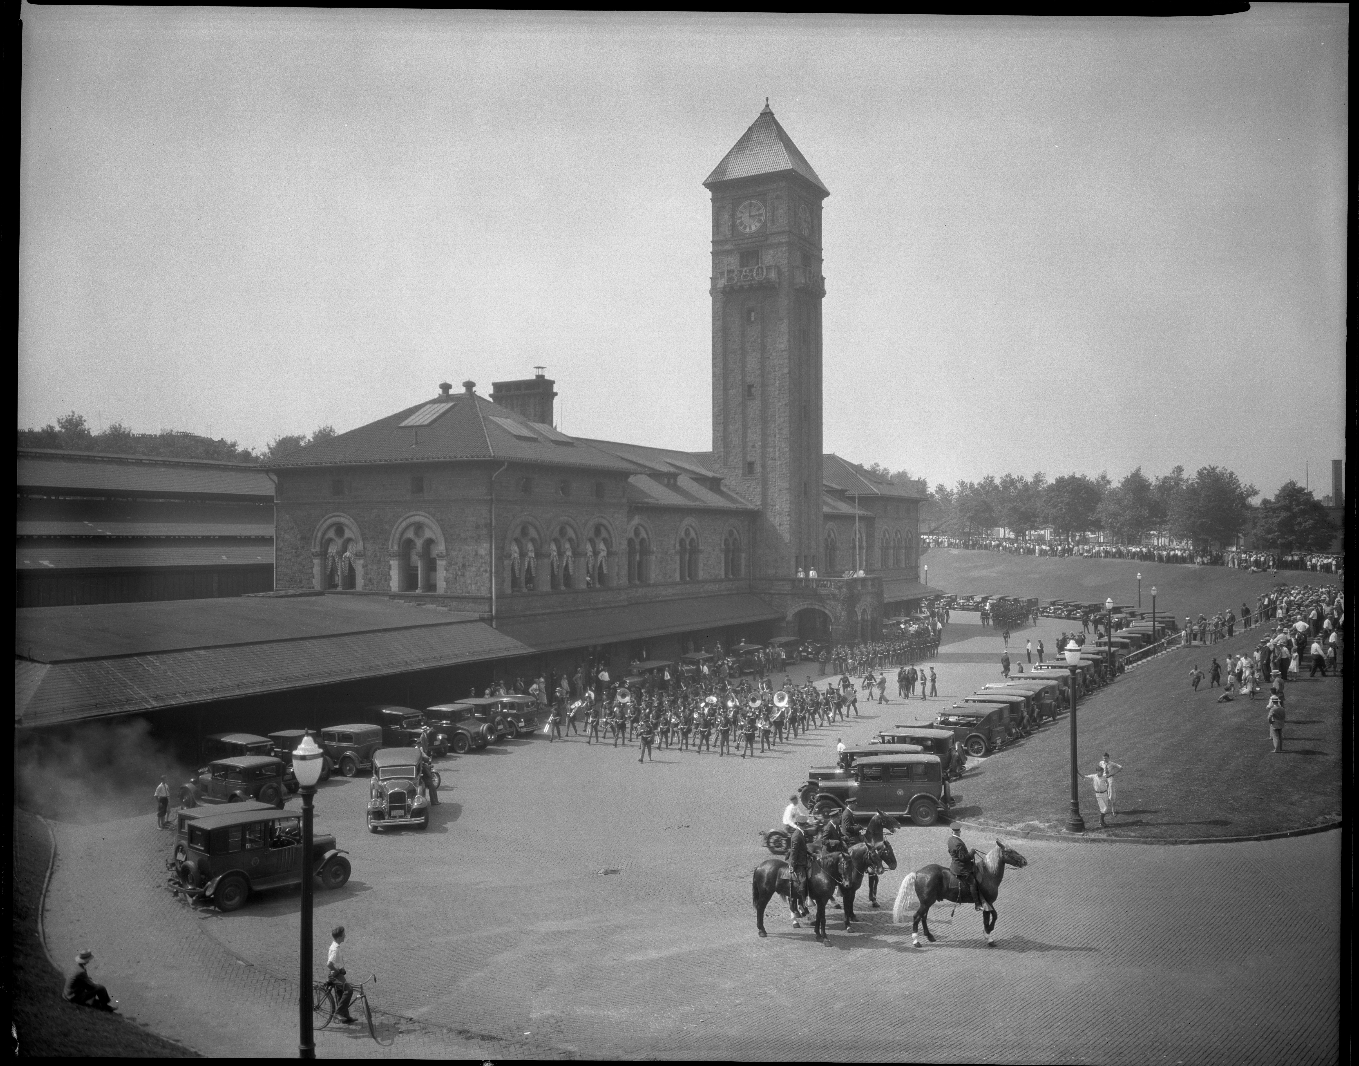
Mt. Royal Station Opening

Slide 27
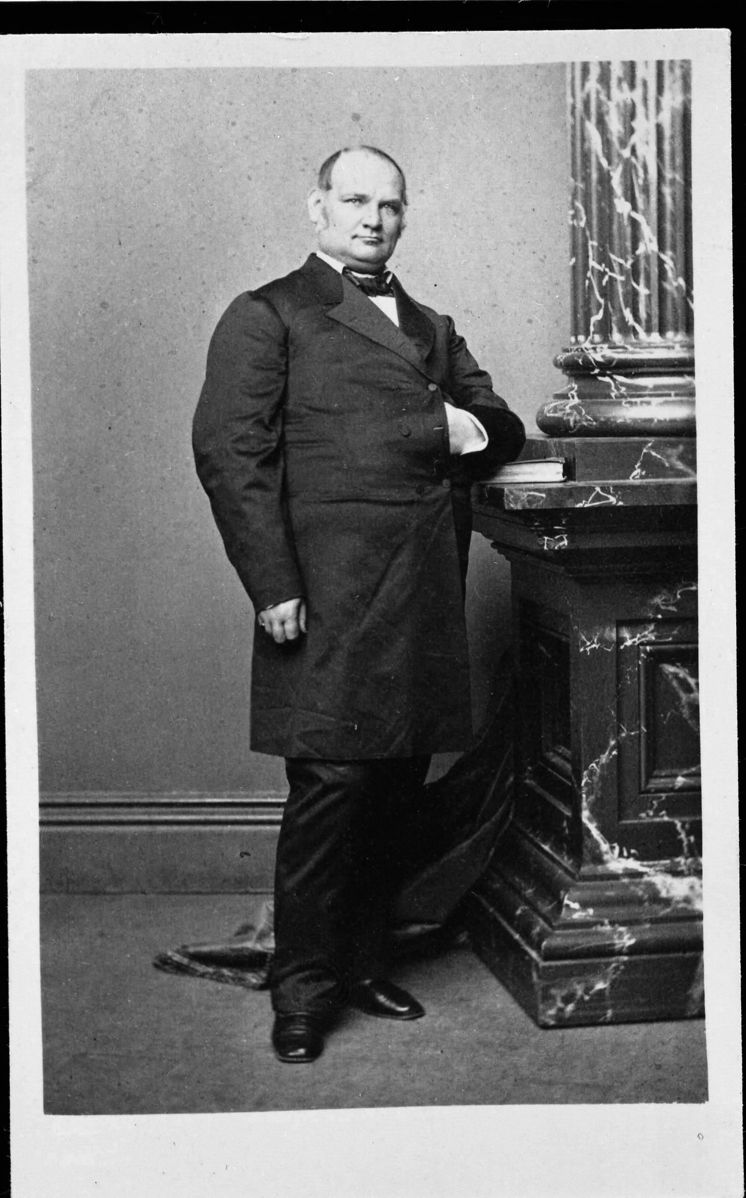
John Work Garrett

Slide 28
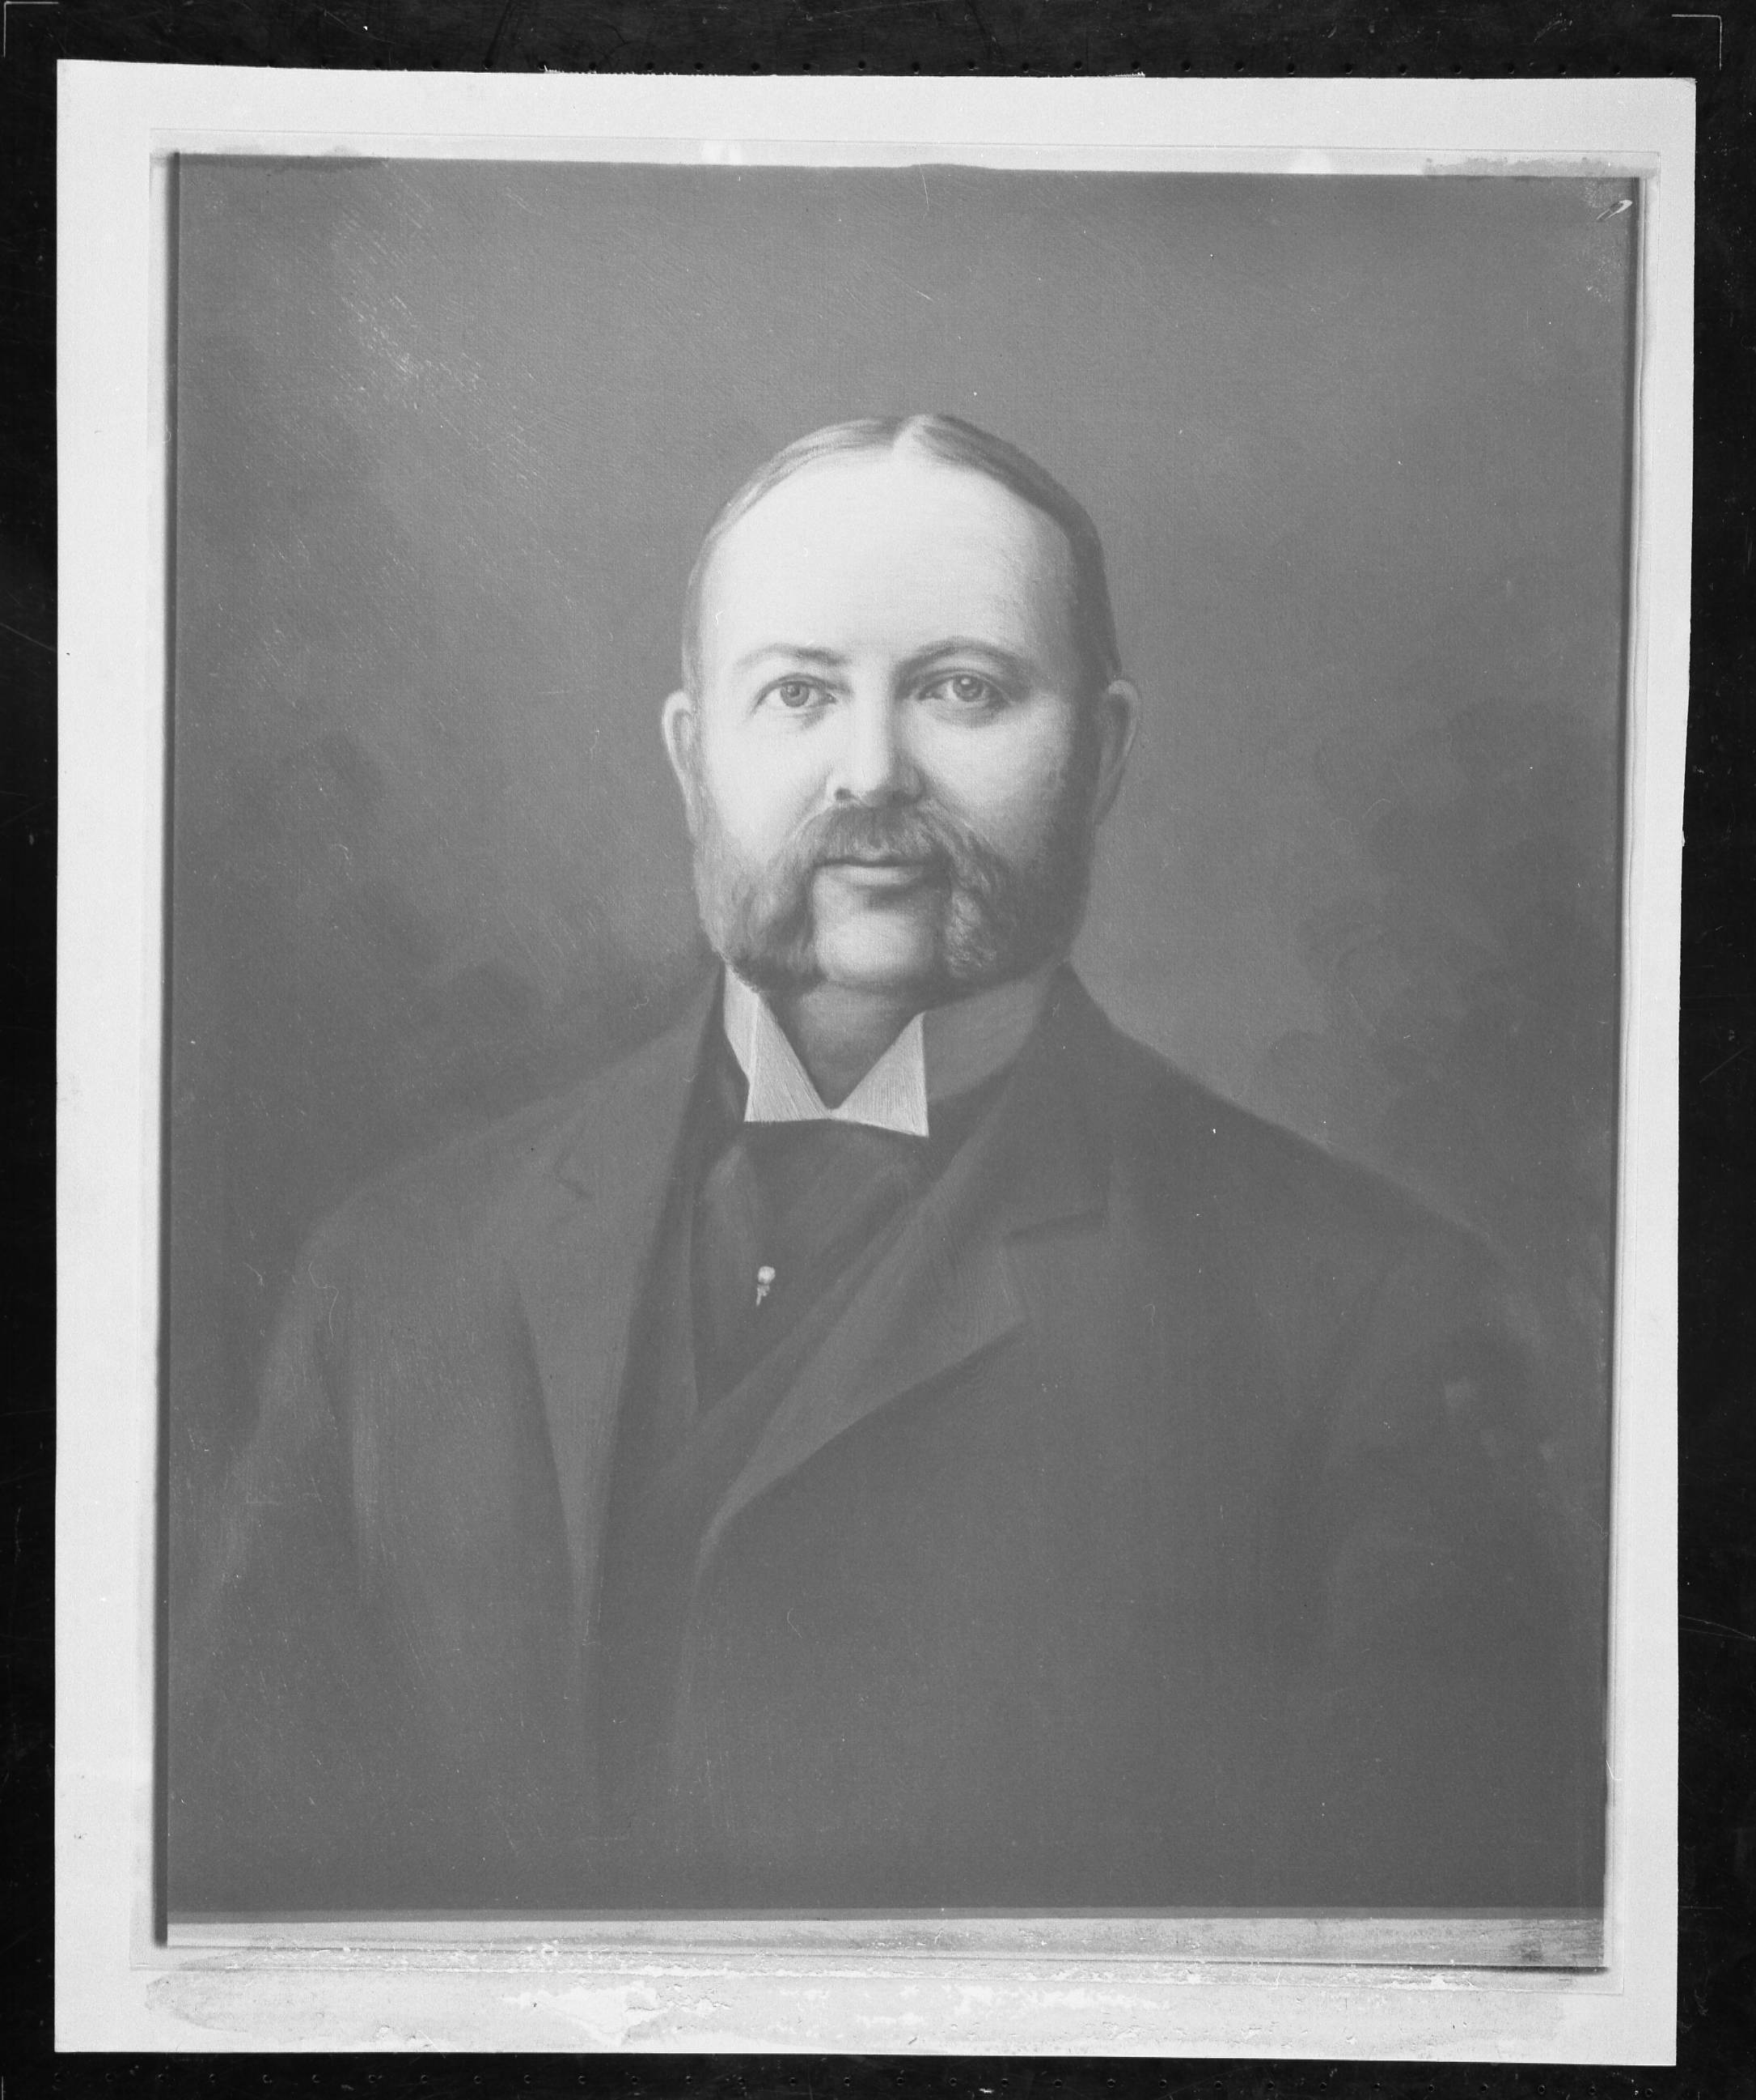
Robert Garrett B&O President

Slide 29
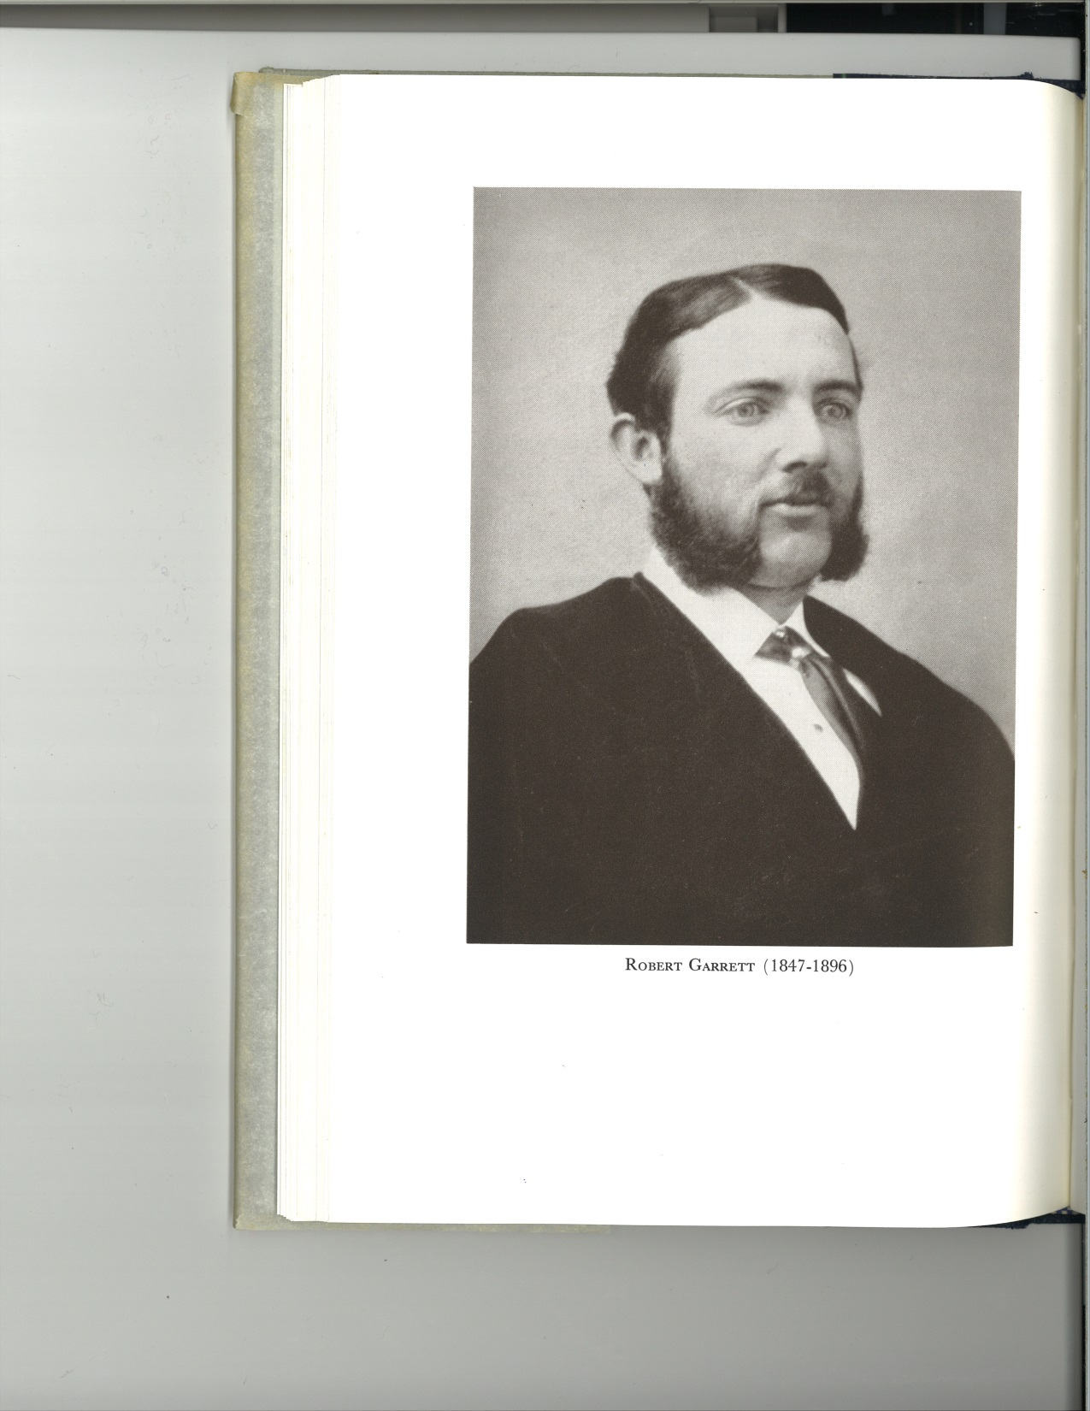
Young Robert Garrett

Slide 30
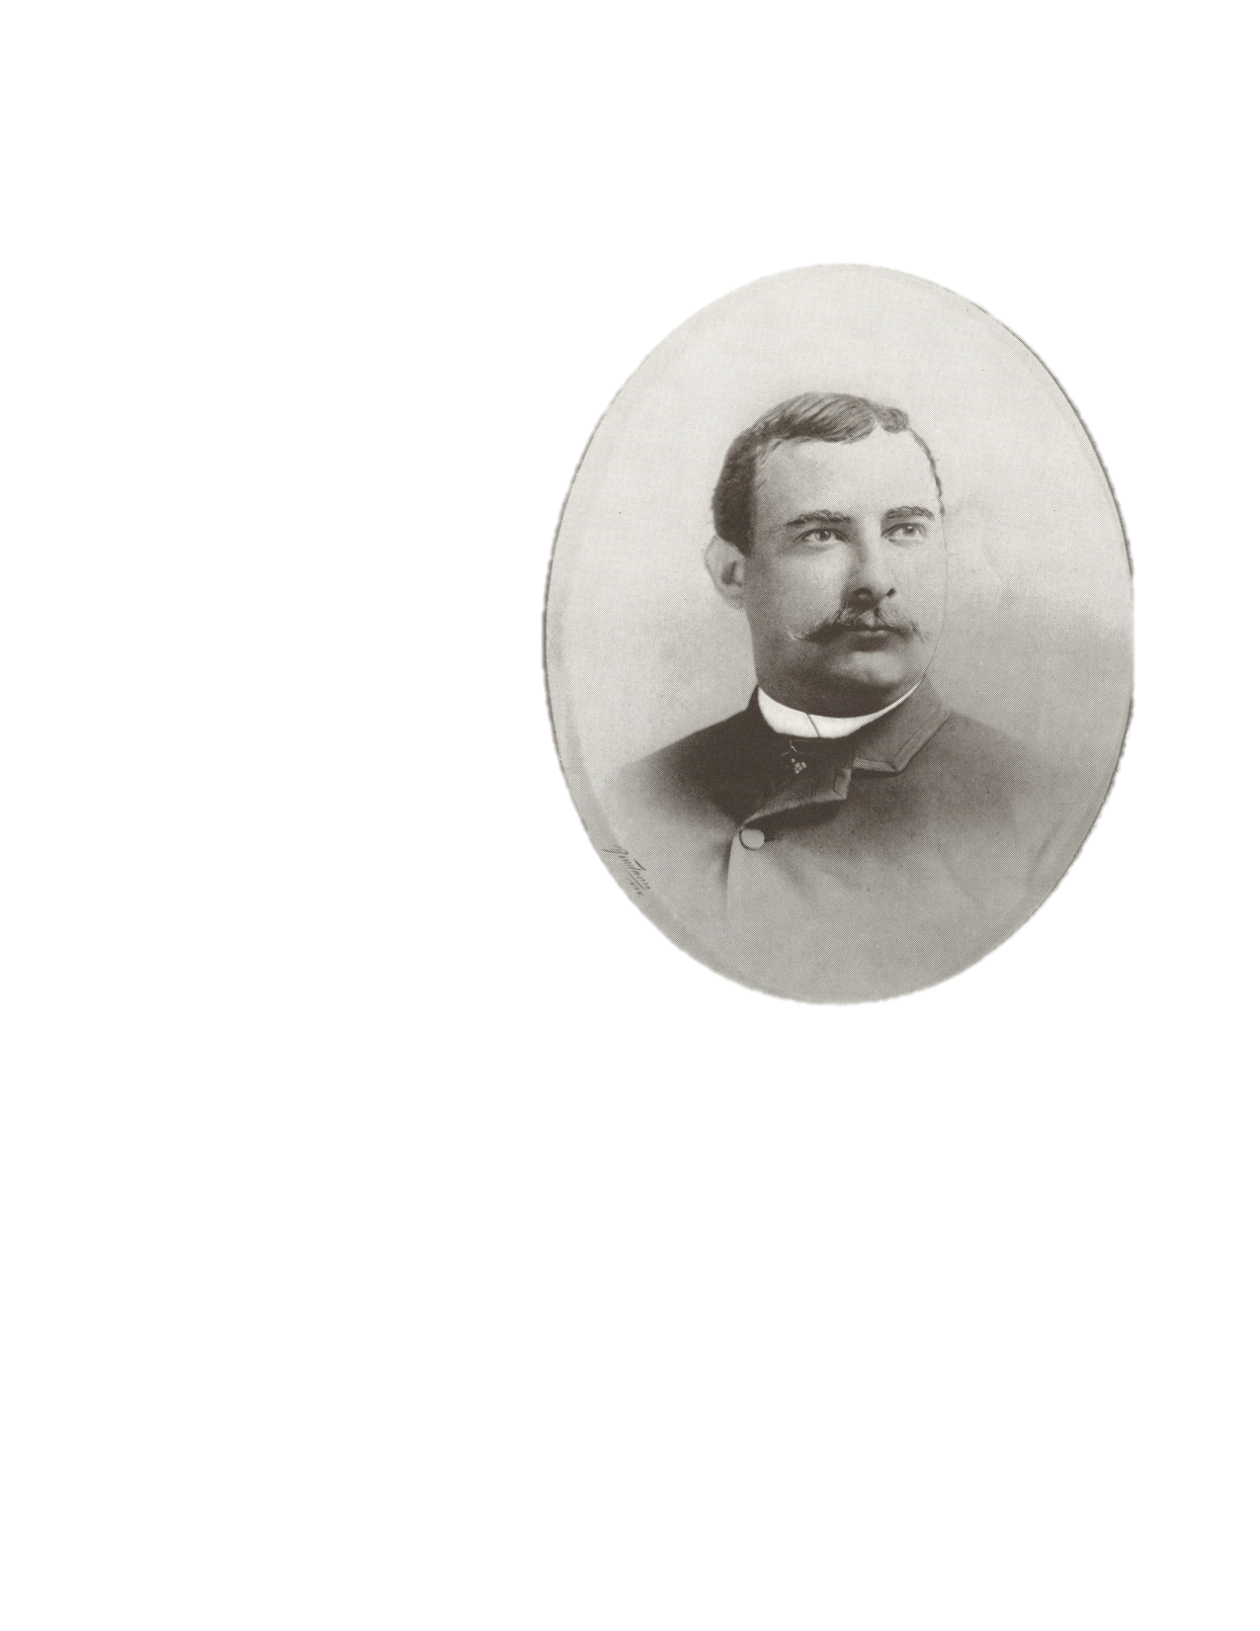
T. Harrison Garrett

