Slide 1
Garrett Women Shape Baltimore
Two Women : Two Paths to Influence
Dr. Bernadette Flynn Low
Professor Emeritus
Community College of Baltimore County

Slide 2
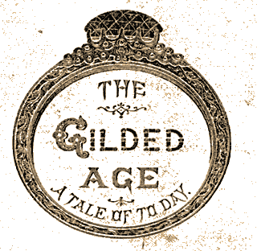
Both Reflect the Gilded Age
Age of beautiful homes
Age of “conspicuous consumption” –characterized by Thorstein Veblen
Age of philanthropists and civic improvement of society
Age of creating sites of beauty and culture --museums, symphony halls, art collections
Age of women’s activism and desire for education
Age of assisting the afflicted

Slide 3
Two Women who Shaped Baltimore
Mary Frick Garrett Jacobs and Mary Elizabeth Garrett:
Their Similarities
Both part of the famous Garrett family
Both come from wealthy Baltimore families
Both cognizant of their social role
Both seek to attain social influence
Both sensitive to the social roles of women
Both shape the city and culture of Baltimore

Slide 4
Different Backgrounds and different Gilded Age visions
Mary Sloan Frick comes from established family
Mary Elizabeth comes from new wealth
Mary Sloan Frick values Victorian ideas--traditional behavior
Mary Elizabeth values “modern” ideas—education and equality for women
Mary Frick embraces traditional roles for women
Mary Elizabeth seeks new roles for women

Slide 5
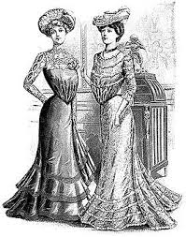
The Education of Mary Frick
Experienced traditional role of women
Appreciated Victorian family values
Studied with a Governess

Slide 6
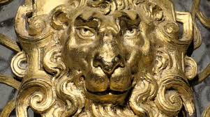
Her Learning Experiences
Family Background
Explorations
Social Obligations
Purchasing powers and Entitlement
Artistic houses
Art and Artifacts
Needs of the Poor

Slide 7

She researched family background
Knew about famous grandfather General Swan and Uplands
Found relative--first governor of Virginia and knighted by King James
Worked to found Colonial Dames of America

Slide 8
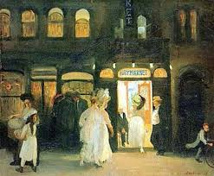
She learned from Travel
Abroad
New York
Newport

Slide 9
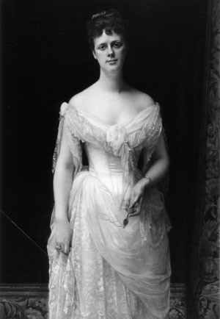
Mary Frick Garrett Jacobs
Social leadership
Artistic houses
Philanthropist
Collector of art
Photos of Mary Frick Garrett Jacobs and house used with permission of Engineering Society of Baltimore

Slide 10
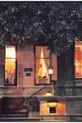
She Envisions a Grand Place, an “Artistic House”
She and her husband receive Mt. Vernon row house as gift from John Work Garrett
They engage Stanford White
They incorporate adjoining row house
They refashion the place

Slide 11
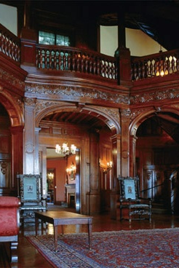
They Create Most Beautiful Urban Mansion in Baltimore
Begin creation of an “Artistic House”
Creation reflects her ideas and skill of Stanford White
She and husbands contribute to beauty and culture of the city

Slide 12
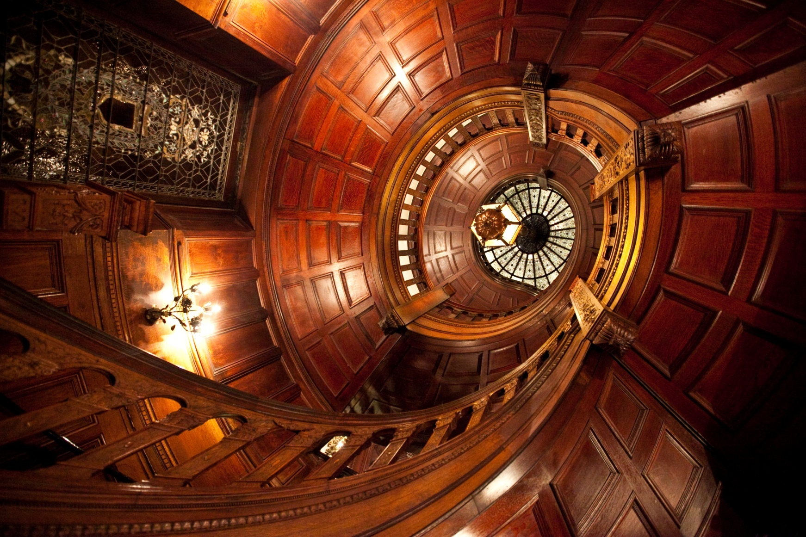
Stanford White and Herter Brothers create the Staircase, a Work of Art

Slide 13
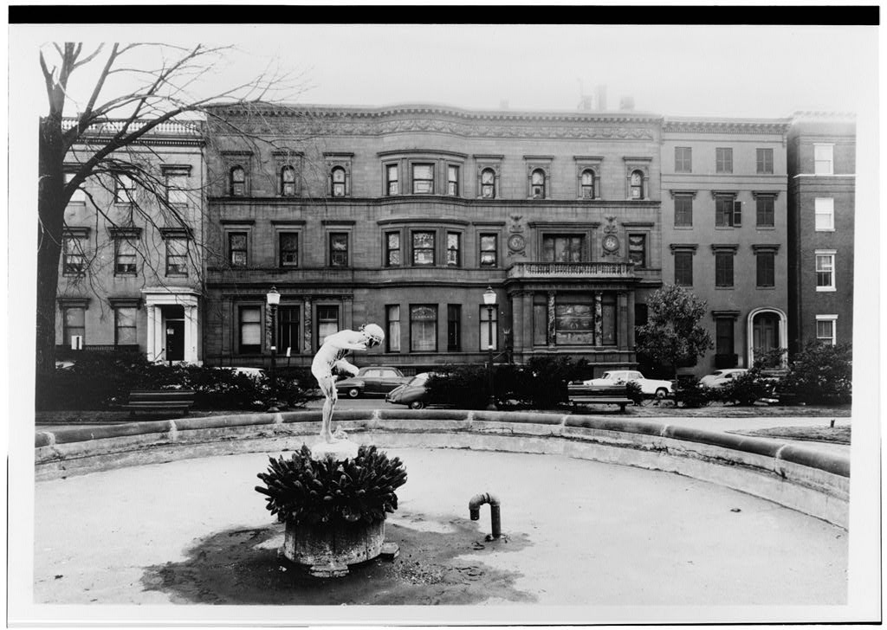
She and Her Husband Attend to the Neighborhood too
Engage Fredrick Olmsted to design Squares around Washington Monument
Adds fountain copied from Champs de Elysee
Commission W.W. Story creator of George Peabody sculpture in London to copy it and place in front of Peabody Library
Begin collection of fine art

Slide 14
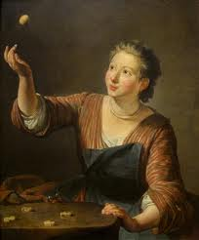
They (she) Collect Art
Rubens
Rembrandt van Rijm: Titus the Son of the Artist
Franz Hals: Dorthea Beck, Wife of Joseph Caymans
Jean Honre Fragonard :The Rest on the Flight into Egypt
Jean Baptiste Simeon Chardin: The Game of Knucklebones
Sandro Botticelli : Madonna Adoring the Child with Five Angels
Louise Elizabeth Vigee-Lebrun: Princess Anna Alexandrova Galitz 1707

Slide 15
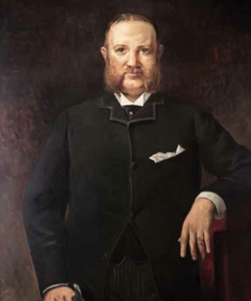
She acts As a Caretaker
Husband has a nervous breakdown
She Helps:
Dr. Henry Barton Jacobs becomes his live-in physician
Inspired by hospital for poor in London, she creates hospital in his honor

Slide 16
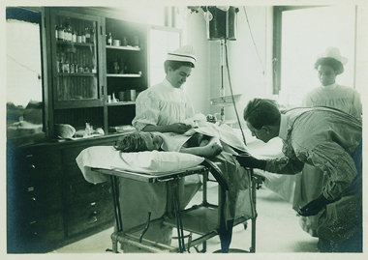
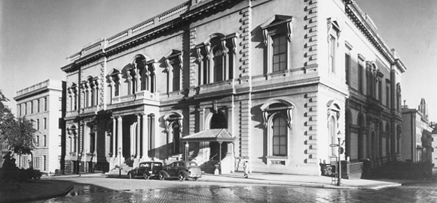
She Creates Robert Garrett Surgical Hospital for Children
Hospital on Cary Street: She funds everything
She creates nurse training programs

Slide 17
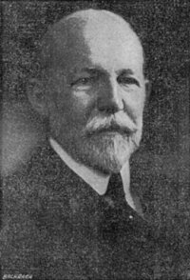
Mary Frick Garrett marries Dr Henry Barton Jacobs
They resume renovations and buy another row house
John Russell Pope designs additions
She focuses on art collection

Slide 18
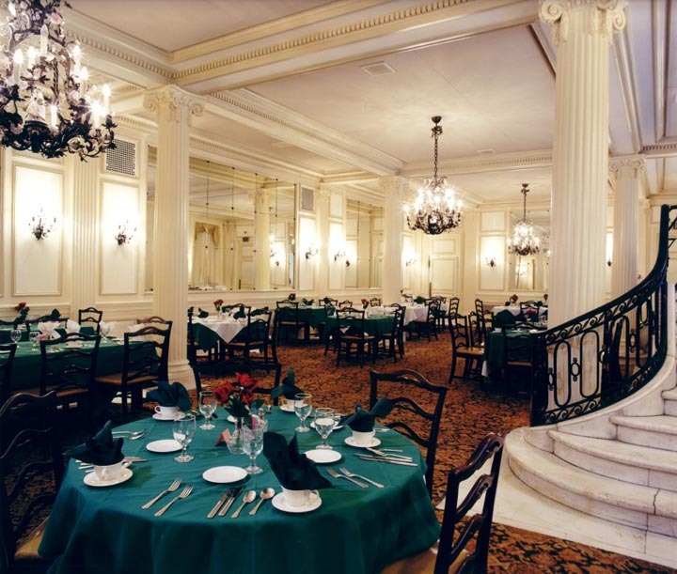
John Russell Pope executes their vision: A grand dining room

Slide 19
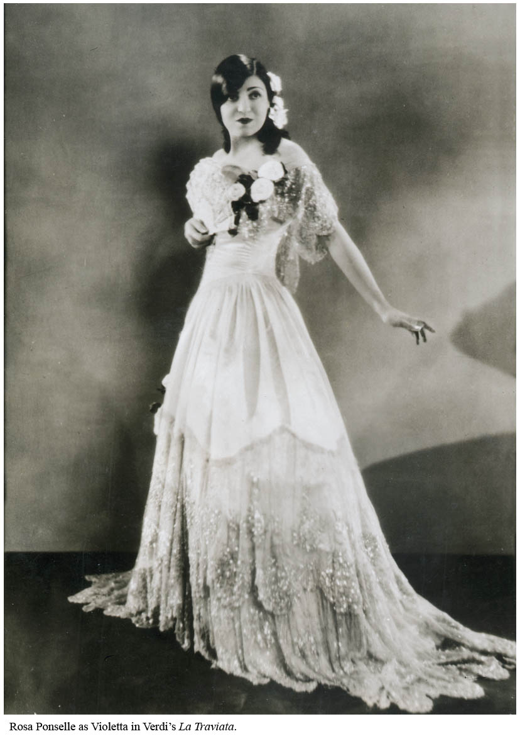
They add a Ballroom-theater-Art Gallery rosa Ponsell Performs

Slide 20
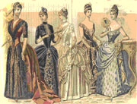
She Epitomizes social role of Gilded Age Woman
Creates domestic beauty
Organizes Colonial Dames of America
Organizes Baltimore Assembly and debutante ball
Starts Baltimore’s famous Flower Mart
Gives annual Christmas parties for city newsboys
Kind to staff-- funds burial and grave marker for former housekeeper, Mrs. Dorsey
Lives the life of the super wealthy

Slide 21
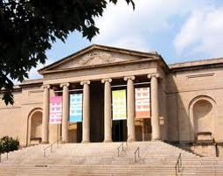
Mrs. Henry Barton Jacobs creates space and leaves art to Baltimore Museum of Art

Slide 22
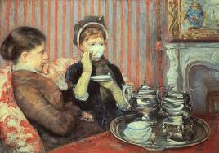
Leaves Uplands home to Episcopal Church for “lonely church women” painting by Jean Honre Fragonart)

Slide 23
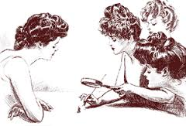
Mary Elizabeth Garrett has a Different style

Slide 24
Mary Elizabeth experiences different education
She attends Miss Kummar’s school in Mt. Vernon
She develops close female friendships
She learns from travelling with her father
She longs for traditional, higher education

Slide 25
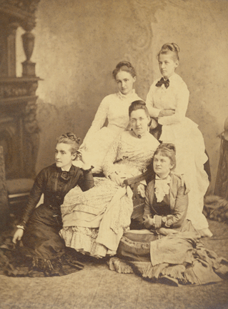
Learning Experiences:
She and Four Friends Create the Friday Night Club
Five Friends constitute the “Friday Night Club”
They talk about ideas as well as hopes and dreams.
They include along with Mary Elizabeth
M. Carey Thomas
Mamie Gwinn
Elizabeth King
Julia King

Slide 26
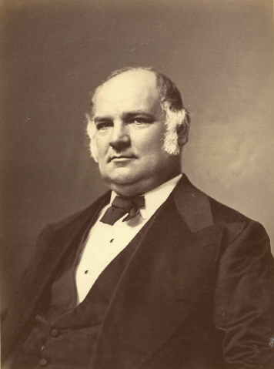
Her father Influences her
Denied her a formal education
Discouraged her suitors
Engaged her assistance in his work
Demonstrated how to be politically effective

Slide 27
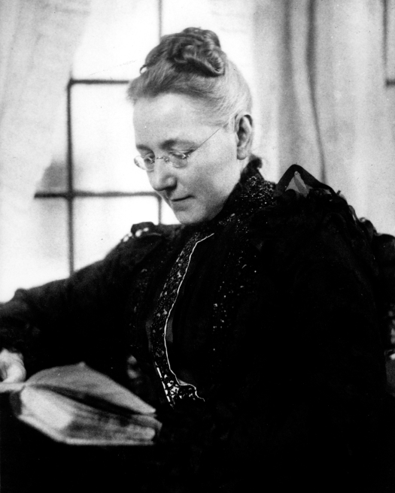
Mary Elizabeth Garrett focuses on education and women
She adapts to what she can do.
She learns from her father.
She wants to make education available to women.

Slide 28
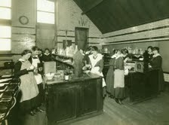
Mary Elizabeth Garrett sees need for equal education for women

Slide 29
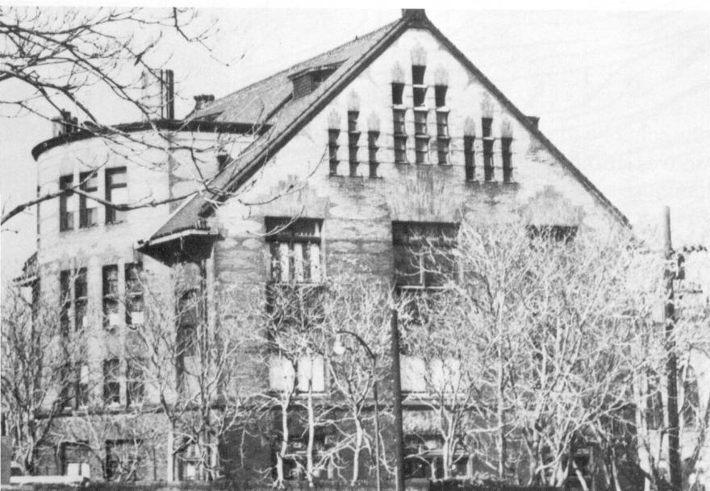
She funds Baltimore College Prep School for Girls
Five Friends discuss how to educate a woman and plan Bryn Mawr College Preparatory School for girls in Baltimore.
They hope to create a gateway to Bryn Mawr College and supports M. Carey Thomas at Bryn Mawr in PA
They develop modern curriculum
She contributes money for state-of-the art facility and supervises all the building
She contributes art work to make it a place of culture and beauty as well as learning

Slide 30
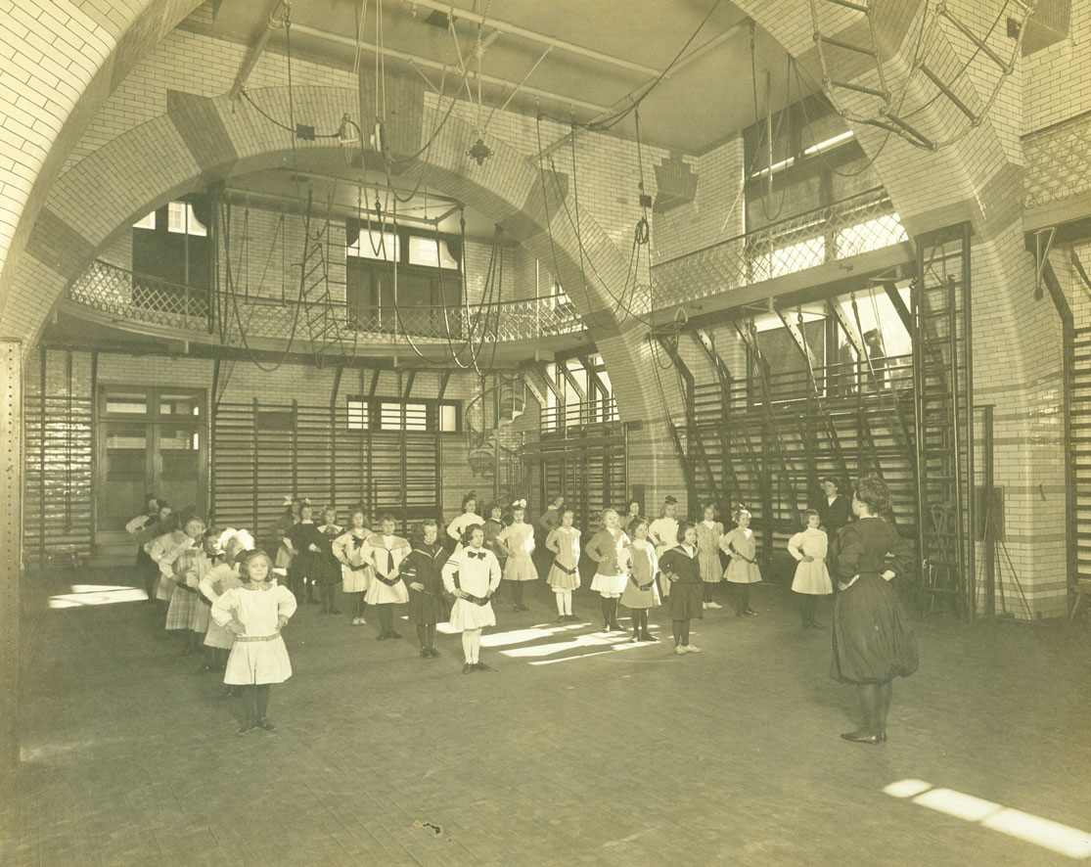
School Emphasizes physical Education

Slide 31
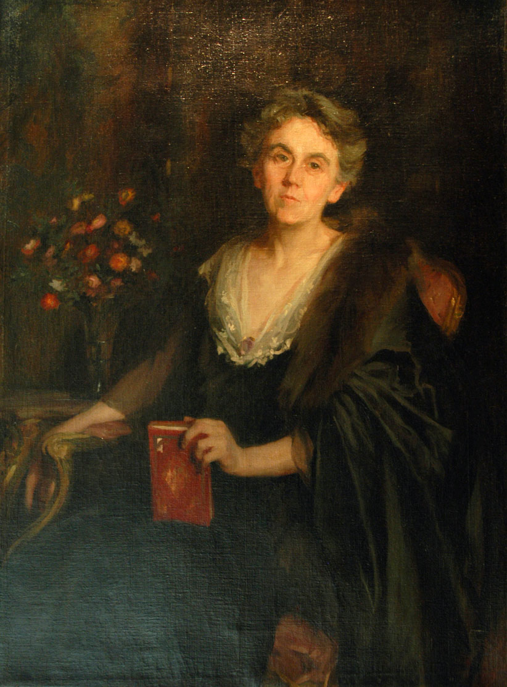
Successful school Emphasizes Classics; engages scholar--
Edith Hamilton-- first Head

Slide 32
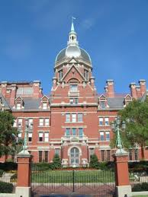
Mary Elizabeth seizes opportunity to provide education for women
Johns Hopkins ran out of money before completing medical school.
Sees opportunity to help start medical school
She and friends raise the funds
She contributes what is needed herself
Insists that women be admitted
Insets on highest academic standards

Slide 33
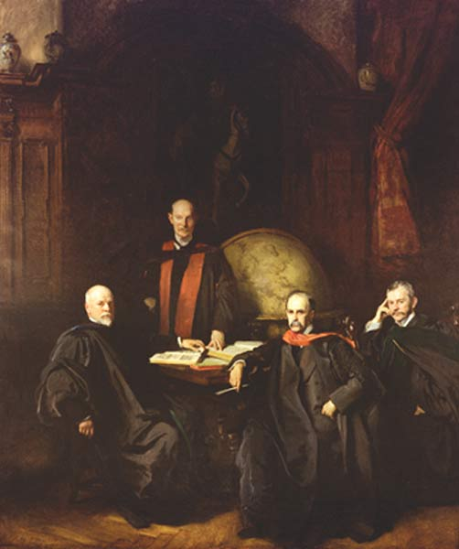
Her Last Gift to Johns Hopkins: John Singer Sargent Portrait of Drs. Welch, Halsted, Kelly, Osler

Slide 34
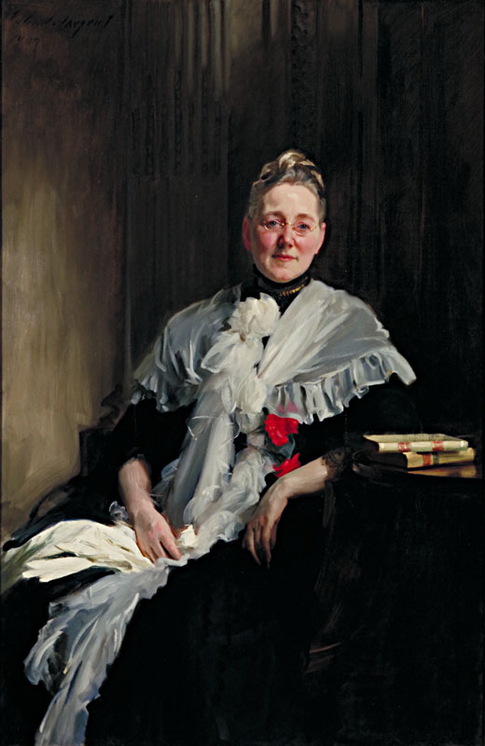
Their Gift of Appreciation:
Her Portrait by John Singer Sargent

Slide 35
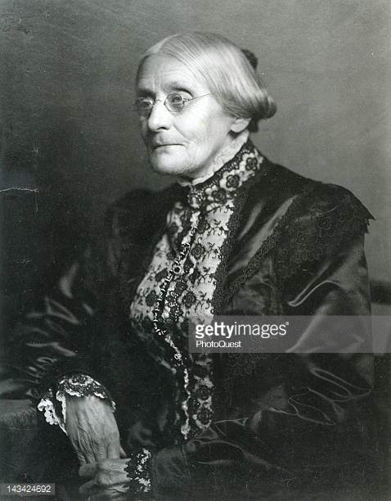
Mary Elizabeth Supports Women’s Movements
Supports Susan B. Anthony and women’s suffrage
Holds fund raisers in Baltimore
Last big event for Susan Anthony

Slide 36
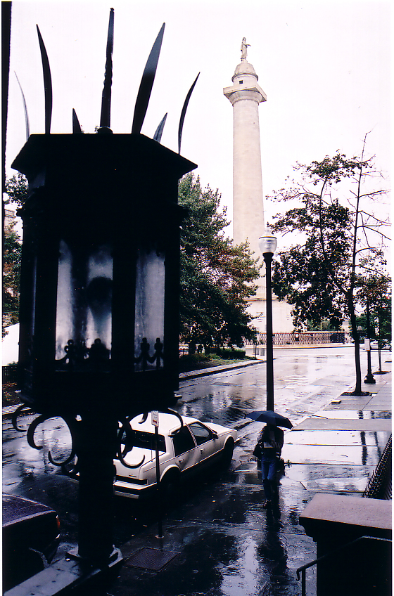
She too is connected with Baltimore museum of art
She leaves home to M. Cary Thomas
Thomas makes it available as first Baltimore Museum of Art before the John Russell Pope building

Slide 37
The Legacy of Two Women
Mary Frick Garrett Jacobs
Creates mansion which becomes Baltimore treasure of beauty and art
Creates and supports for fifty years the Robert Garrett Surgical Hospital for children with summer space in Mt. Airy.
Focuses on providing help and training for working women
Gives Uplands home for lonely, needy women
Bequeaths art and Mary Jacobs wing to BMA
Mary Elizabeth Garrett
Provides funding for Johns Hopkins Medical Institute with stipulation of admission of women and highest standards in nation.
Creates state-of-art school for young girls in Bryn Mawr Prep and Bryn Mawr College
Supports suffrage
Leaves legacy of support for advanced education of women
Works for education and equality for women

Slide 38
Two Garrett Women in Baltimore

